Slide 1






Web Programming PHP & MySQL khirulnizam.com

Slide 2
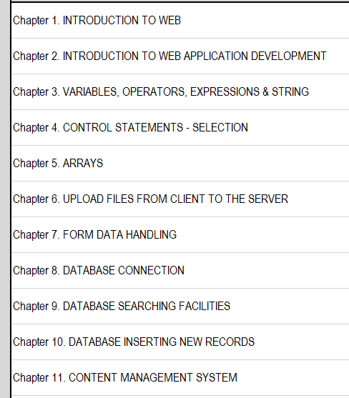
outline
TBTM2053
Web Programming

Slide 3




3-tier
Tier3 : Database
Tier1 : Client/browser
Tier2 : Middleware (Webserver + PHP)

Slide 4


T1: CLIENT (BROWSER HTML)
The User-interface

Slide 5
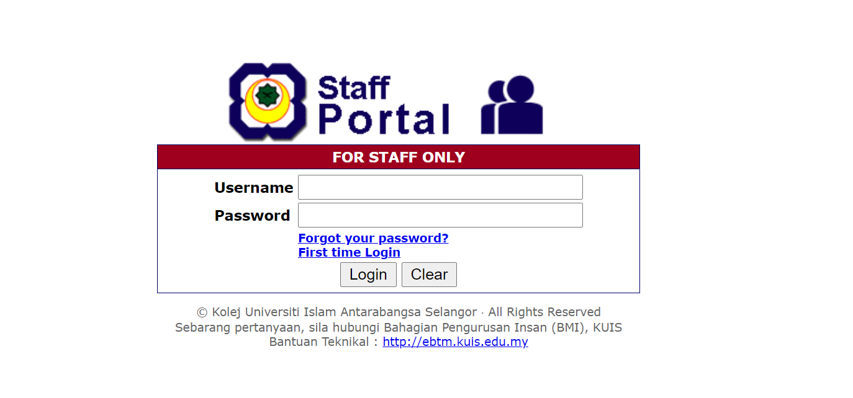
Web APPLICATION PROCESS

Slide 6

T2: Web server + PHP interpreter
Hold logic/ business process
Server-side scripting
Dynamic web

Slide 7

T3: DATABASE
Place to hold database/records/data

Slide 8

LARAGON.ORG
Development stack
https://laragon.org/download.html
Apache/ Nginx / PHP/ MySQL / NodeJS / etc…

Slide 9
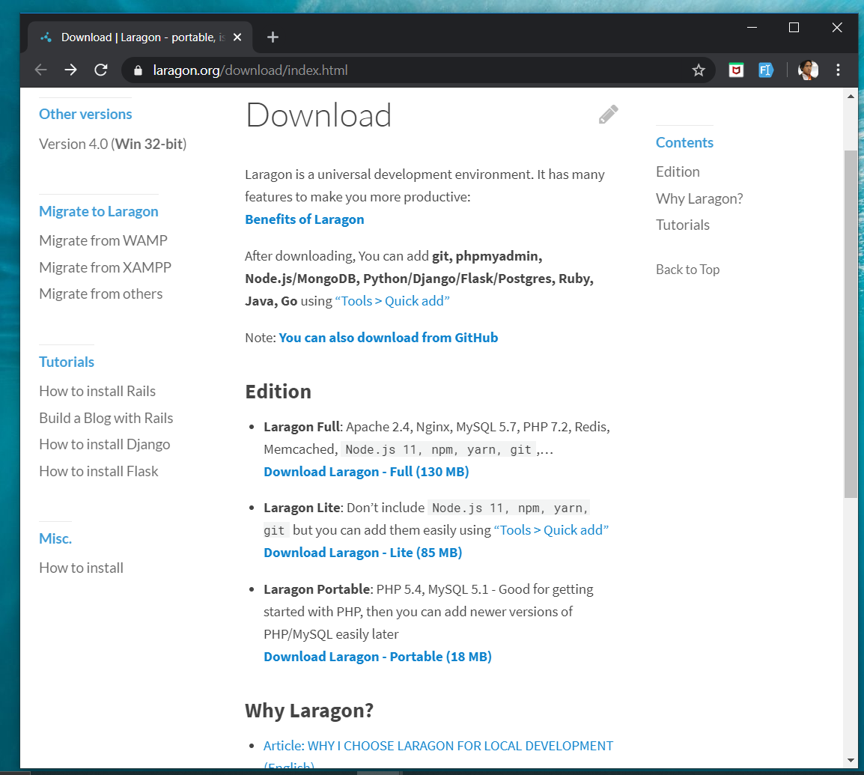
DOWNLOAD
Laragon.org/download

Slide 10
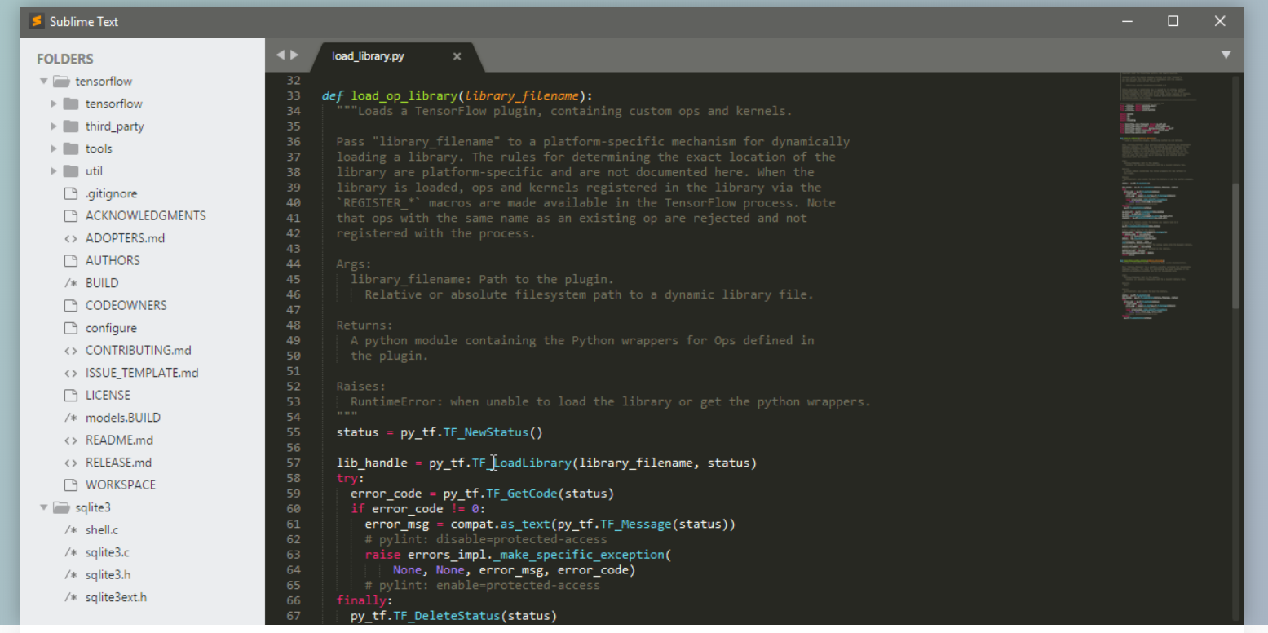
www.sublimetext.com

Slide 11
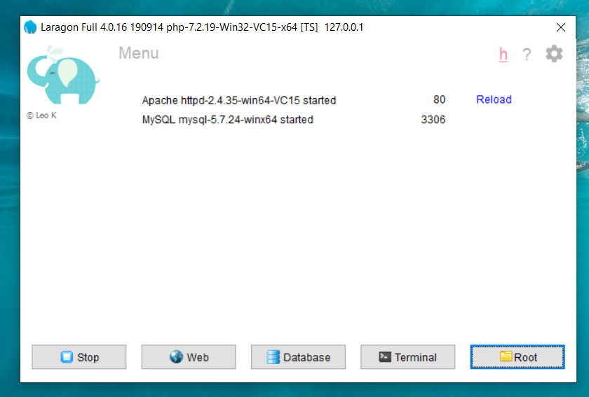
LARAGON INTERFACE
Start/stop servers
localhost
db client (HeidiSQL)
cli/npm/composer
go to webroot folder

Slide 12



T01 HTML5 & Bootstrap (Web Programming)
FSTM KUIS

Slide 13

T01 HTML5
w
bit.ly/fstmtube

Slide 14
Training outline
HTML5 – refers to the modern day of HTML which promotes native handling of video & audio & animation without having to install additional plugins to browser.
Bootstrap – A HTML framework supports responsive web design to provide one time webpage development for smartphone, tablet and desktop.

Slide 15
HTML5
HTML5 – refers to the modern day of HTML which promotes native handling of video & audio & animation without having to install additional plugins to browser.
<!DOCTYPE html>
Try: https://www.w3schools.com/html/tryit.asp?filename=tryhtml_headings

Slide 16
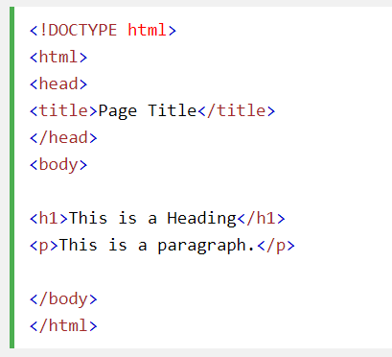
Typical HTML CODE

Slide 17
HTML5 image handling
<img src="pic_mountain.jpg" alt="Mountain View" style="width:304px;height:228px;">
Use width 100% to support responsive layout design.
Try: https://www.w3schools.com/html/tryit.asp?filename=tryhtml_images_trulli

Slide 18
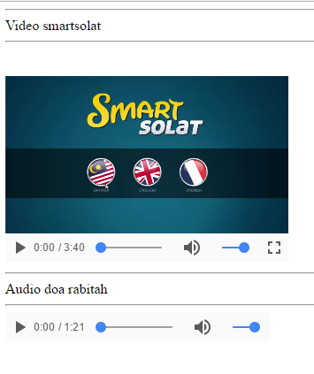
HTML5 Native video
<video width="320" height="240" controls> <source src="movie.mp4" type="video/mp4"> <source src="movie.ogg" type="video/ogg"> Your browser does not support the video tag. </video>
Try: https://www.w3schools.com/html/tryit.asp?filename=tryhtml5_video

Slide 19
HTML5 Native AUDIO
<audio controls> <source src="horse.ogg" type="audio/ogg"> <source src="horse.mp3" type="audio/mpeg"> Your browser does not support the audio element. </audio>

Slide 20
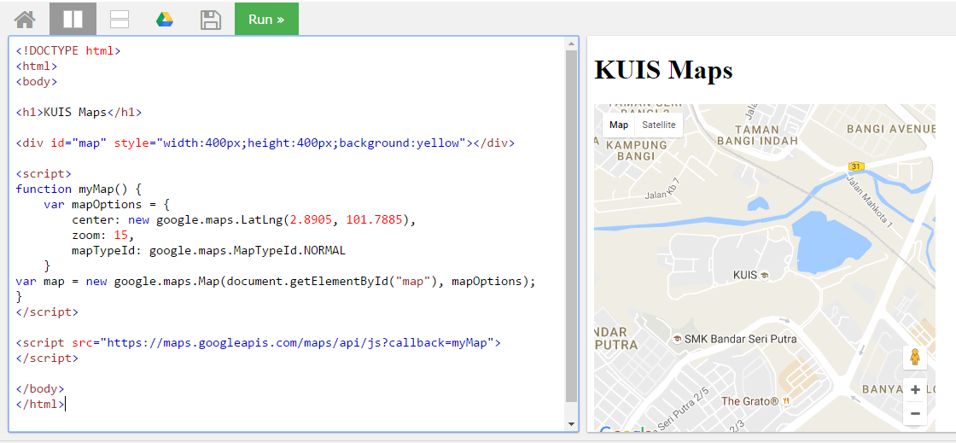
Location MAPS

Slide 21
T02 Bootstrap + Responsive Layout
FSTM KUIS

Slide 22
T02 BOOTSTRAP + RESPONSIVE LAYOUT
FSTM KUIS

Slide 23
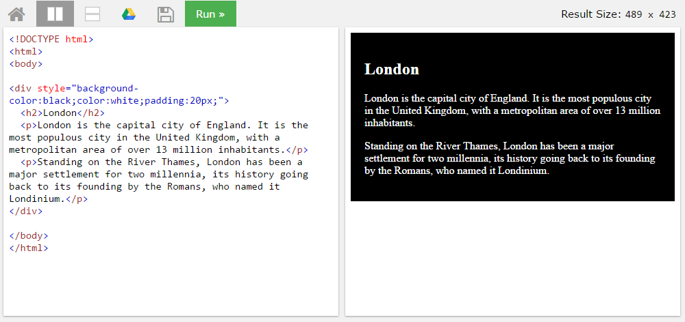
BLOCK <DIV>

Slide 24
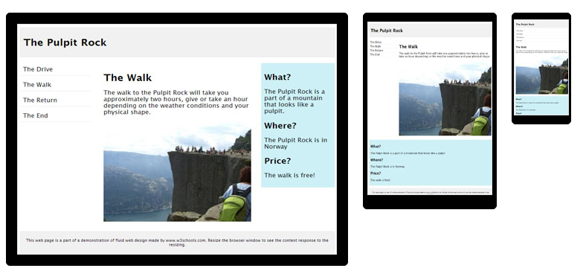
HTML Responsive layout

Slide 25
HTML Responsive layout
What is Responsive Web Design?
Responsive Web Design makes your web page look good on all devices (desktops, tablets, and phones).
Responsive Web Design is about using CSS and HTML to resize, hide, shrink, enlarge, or move the content to make it look good on any screen

Slide 26
VIEWPORT
<meta name="viewport" content="width=device-width, initial-scale=1">
The viewport varies with the device, and will be smaller on a mobile phone than on a computer screen.
The initial-scale=1.0 part sets the initial zoom level when the page is first loaded by the browser.

Slide 27
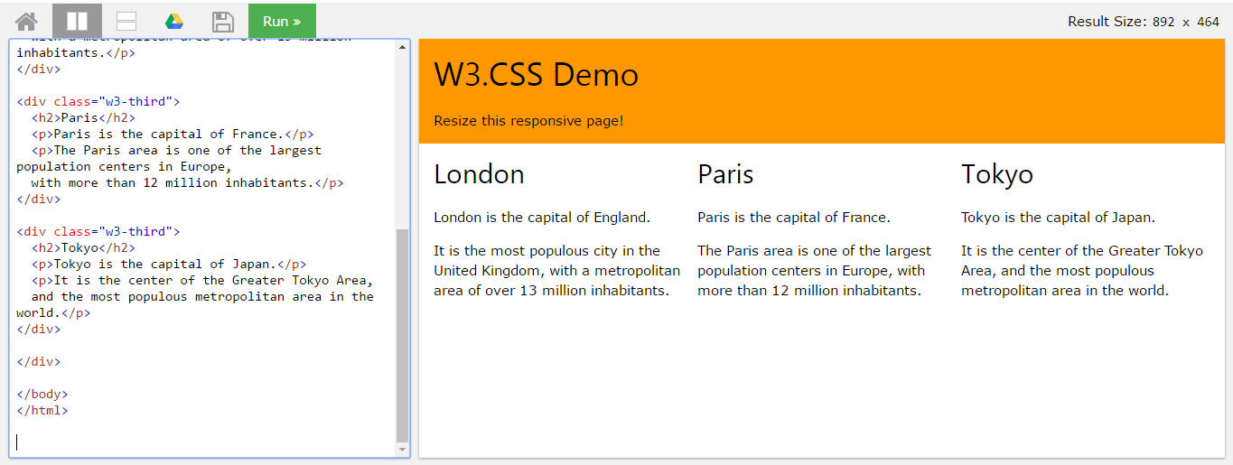
HTML Responsive layout

Slide 28
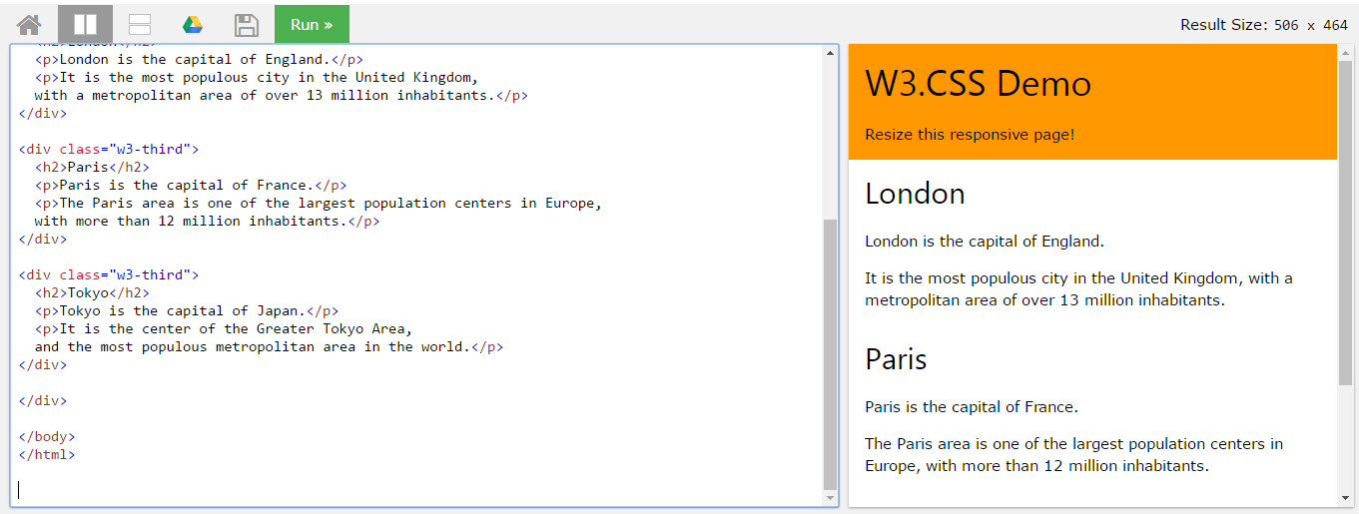
HTML Responsive layout

Slide 29

Bootstrap
A HTML framework supports responsive web design to provide one time webpage development for smartphone, tablet and desktop.

Slide 30
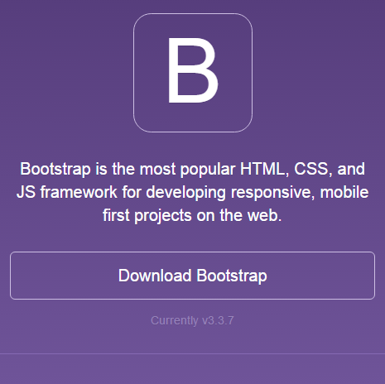
Bootstrap
Download framework from getbootstrap.com
OR use the CDN

Slide 31
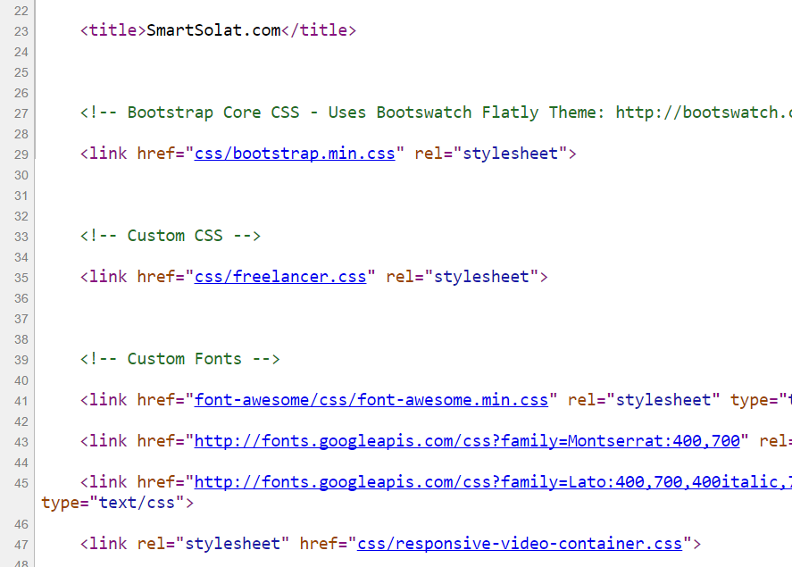
Bootstrap -setting
Copy the CSS script to the project folder.
> OR we can use CDN server

Slide 32
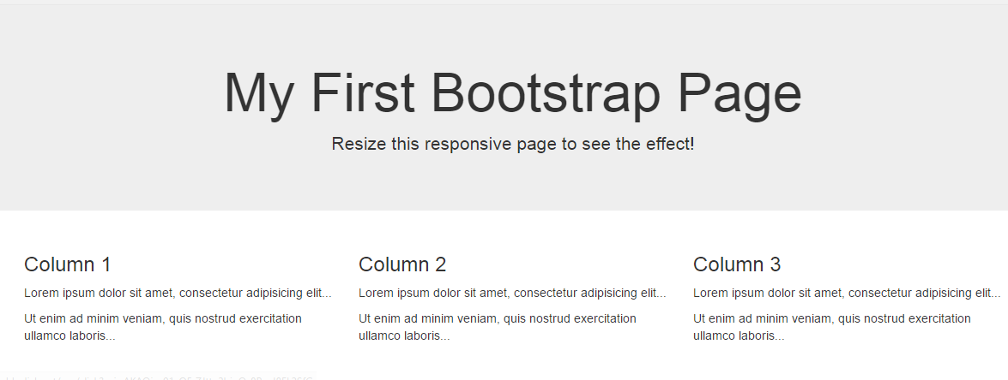
Basic bootstrap layout
Try it here http://www.w3schools.com/bootstrap/tryit.asp?filename=trybs_default&stacked=h

Slide 33
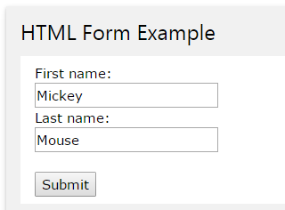
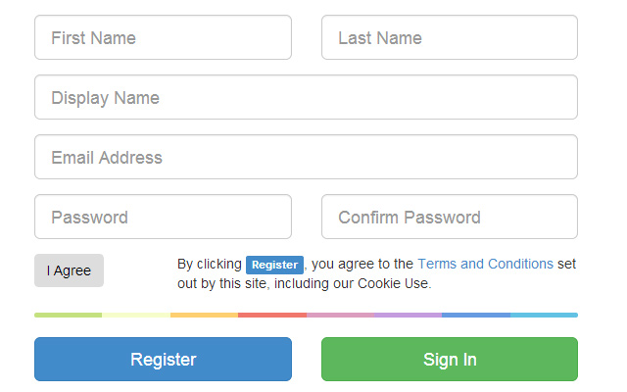
BOOTSTRAP FORM

Slide 34
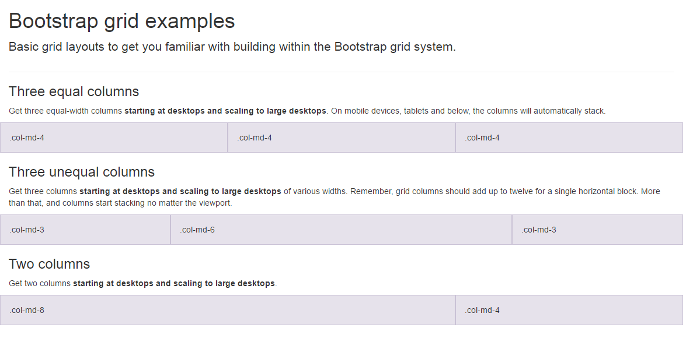
BootSTRAP GRID SYSTEM

Slide 35
BootSTRAP GRID SYSTEM DESKTOP
Banner
Main Content
Sidebar
Footer

Slide 36
BootSTRAP GRID SYSTEM MOBILE
Banner
Main Content
Sidebar
Footer

Slide 37
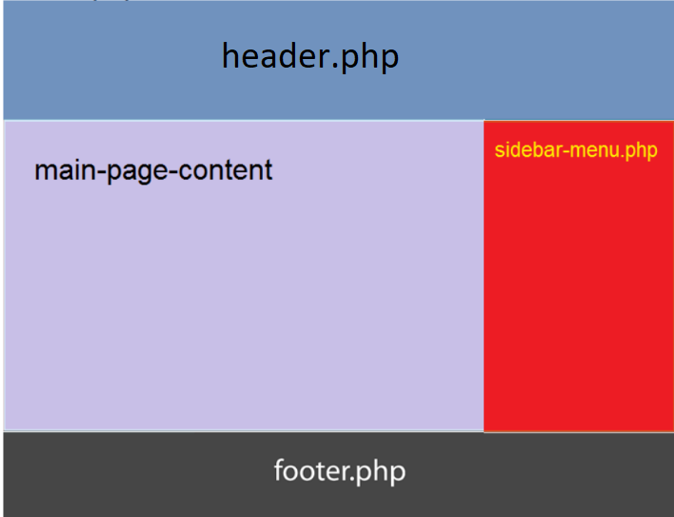
Include php
include (“header.php”);
<our content>
include (“footer.php”);

Slide 38

FREE STARTbootstrap.com
Example https://startbootstrap.com/

Slide 39
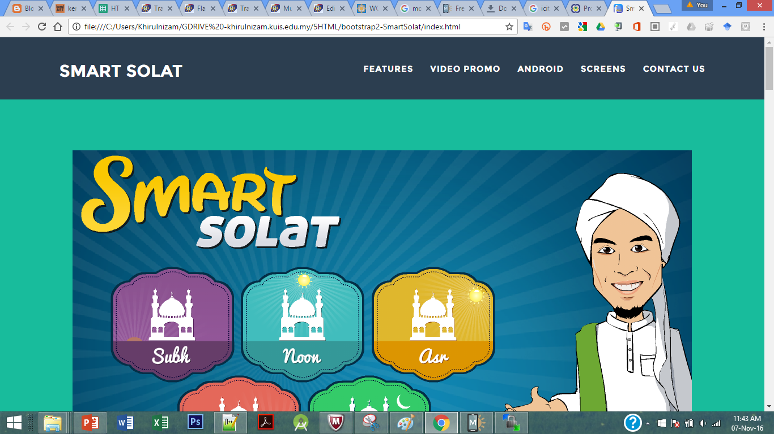
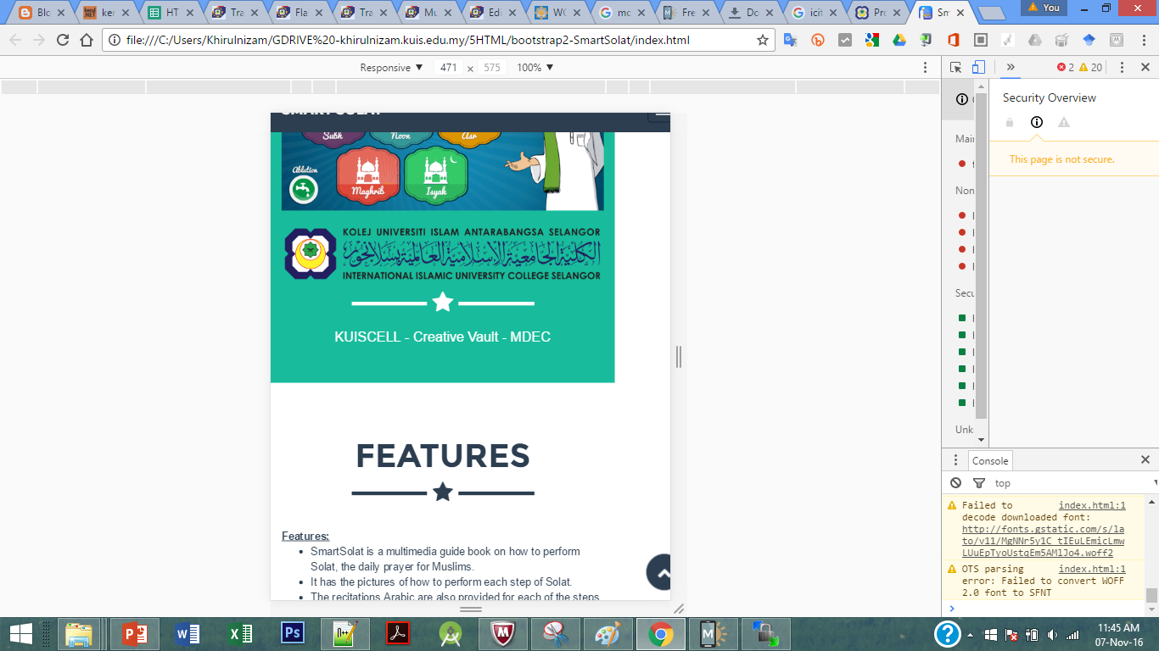
Sample2 - smartsolat

Slide 40
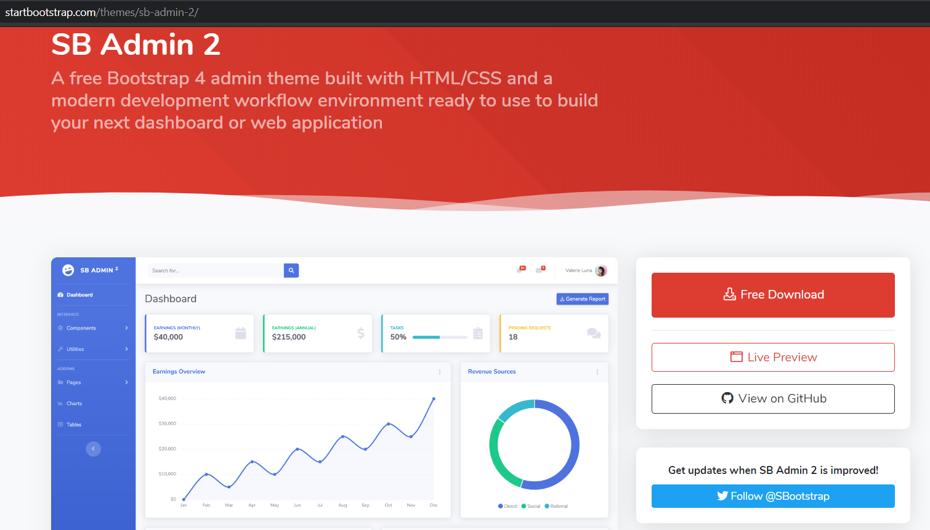
startbootstrap.com/themes/sb-admin-2/

Slide 41

T02.1 HTML + Bootstrap Form (Web Programming)
bit.ly/fstmtubephp

Slide 42
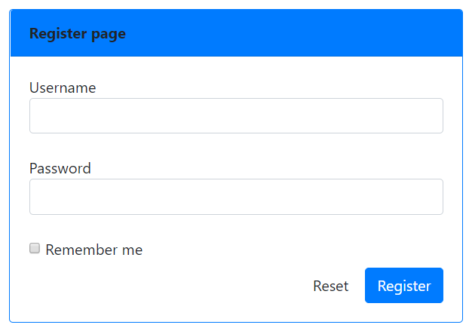
OUTPUT PREVIEW

Slide 43

DISCLAIMER
Codes are for demo purposes. Example showed here are only to validate the proof of concepts. Security aspect the demonstrated examples are beyond the coverage of these video tutorials. You are advised to explore / sought after advanced/security topics of PHP web programming as these tutorials only for beginner level.
Suitable to view in DESKTOP

Slide 44

CONNECT TO MYSQL DATABASE
mysqli
E-book PHP&Mysqli get it from
khirulnizam@gmail.com or
http://fb.com/khirulnizam or
Instagram @kerul_net
Video tutorial will cover mysqli

Slide 45
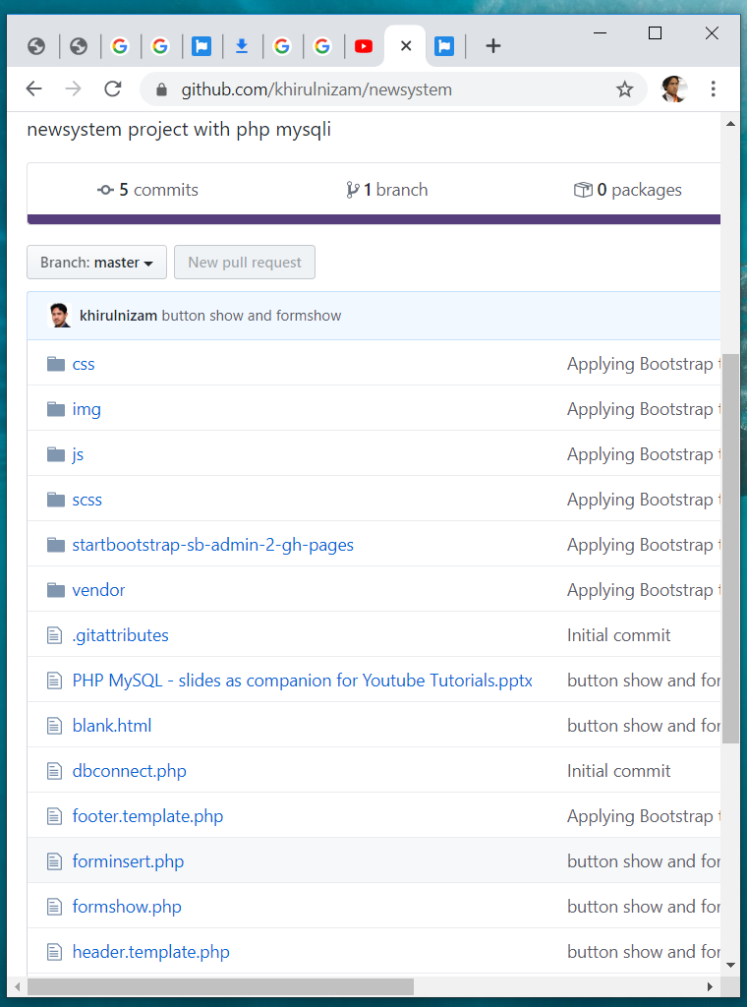

Code & Slides github.com/khirulnizam/ newsystem

Slide 46
BOOTSTRAP FORM

Slide 47
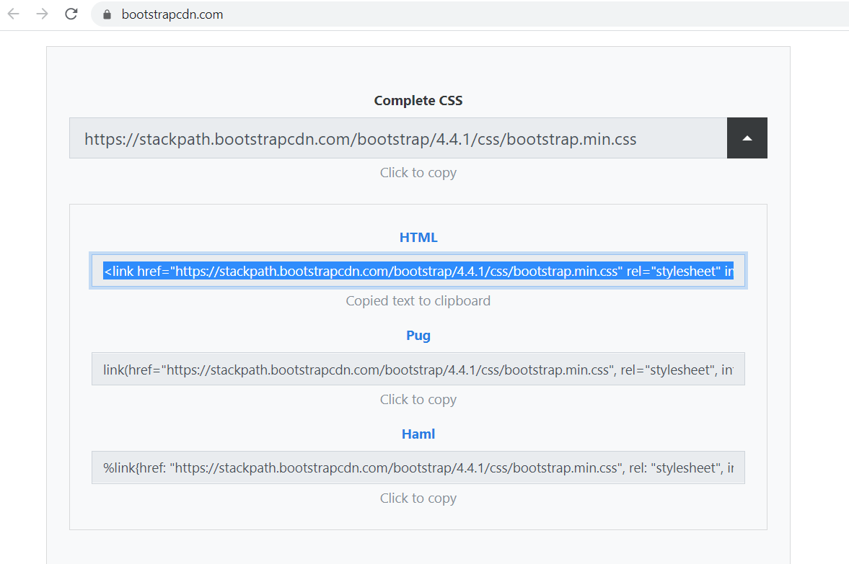
BootstrapCDN.com

Slide 48
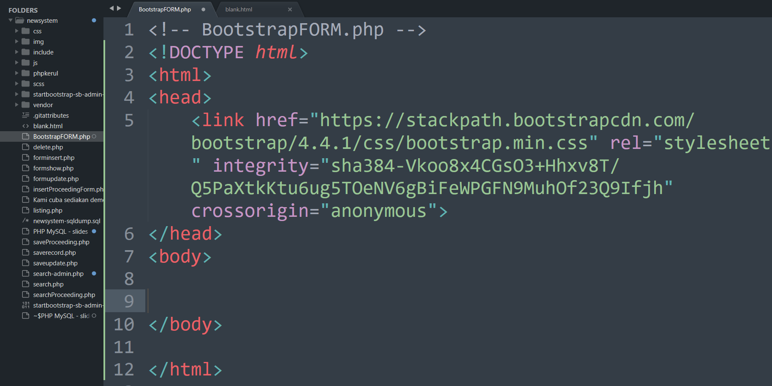

Slide 49
BootSTRAP GRID SYSTEM

Slide 50
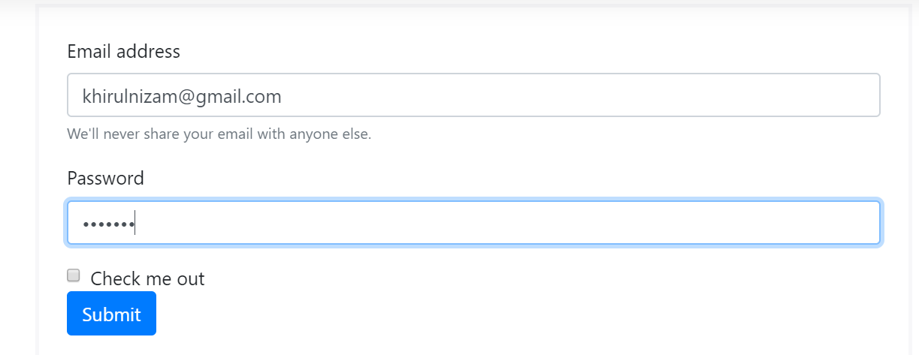
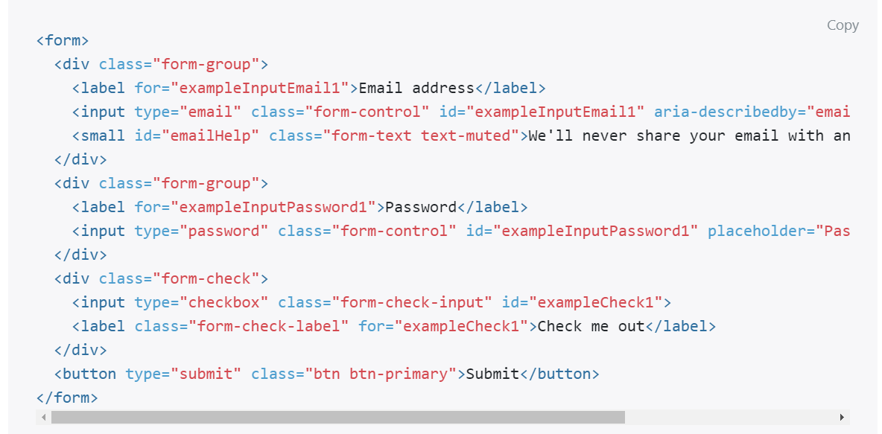
Email & PASSWORD

Slide 51
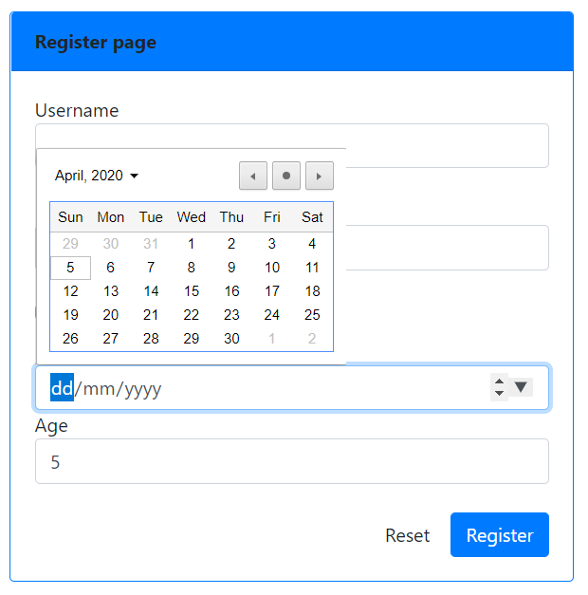
Date & NUMBER
<div >
Date of birth
<input type="date" name="dob" class="form-control">
Age
<input type="number" name="age" class="form-control">
</div>

Slide 52
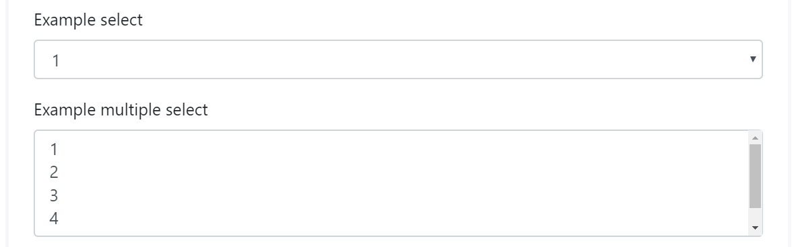
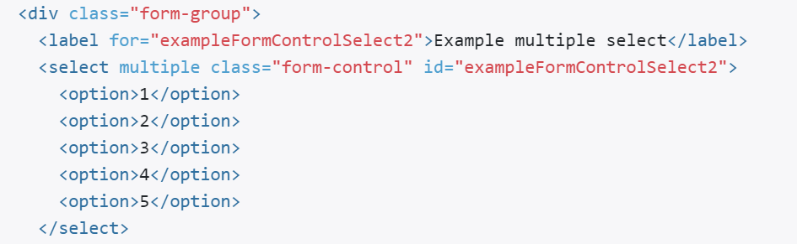
SELECT (DROP-DOWN)

Slide 53
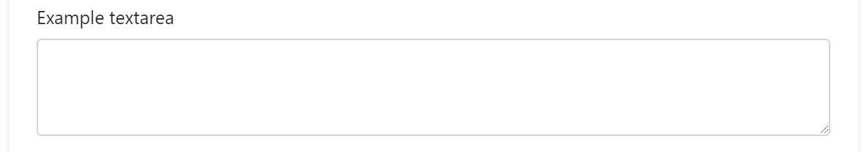
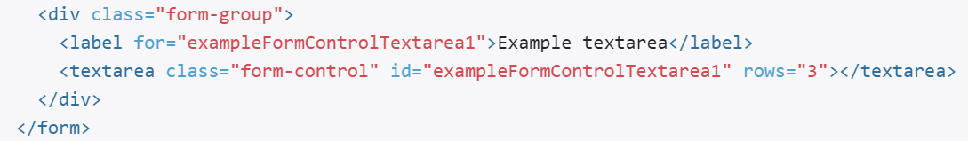
TEXTAREA

Slide 54
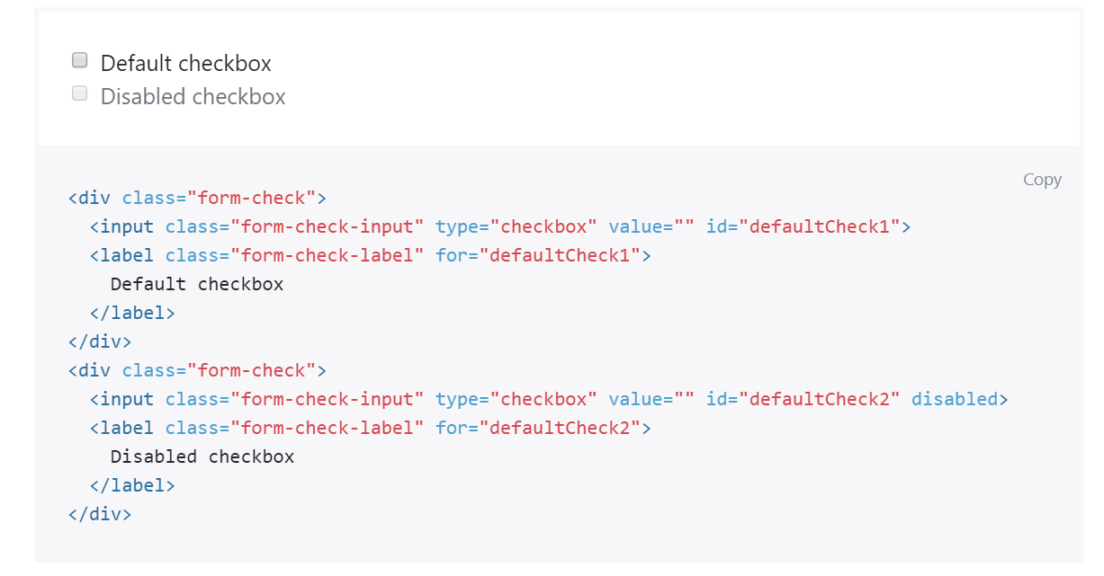
CHECKBOX

Slide 55
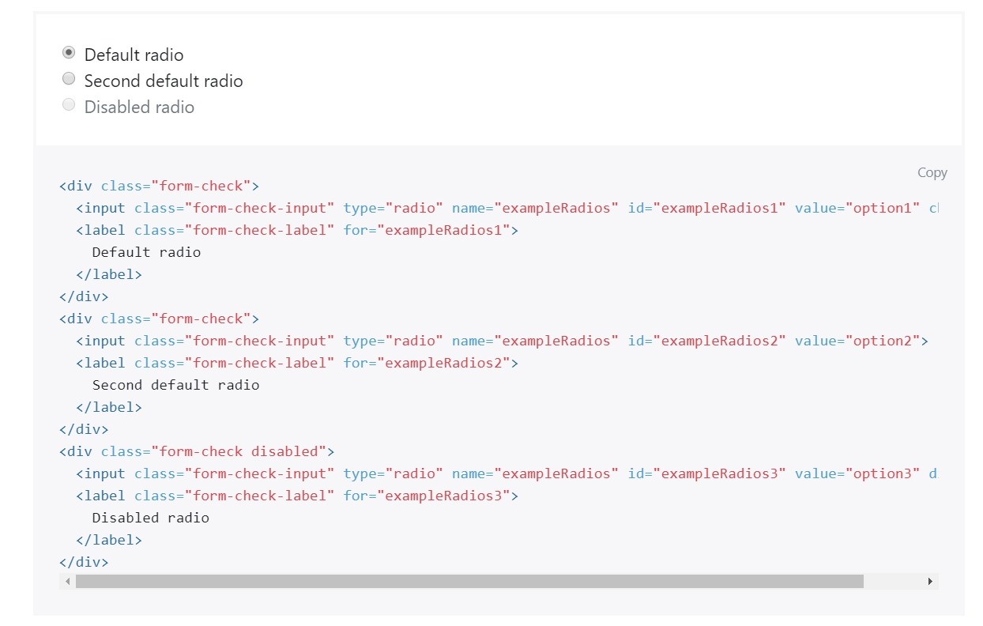
RADIO

Slide 56
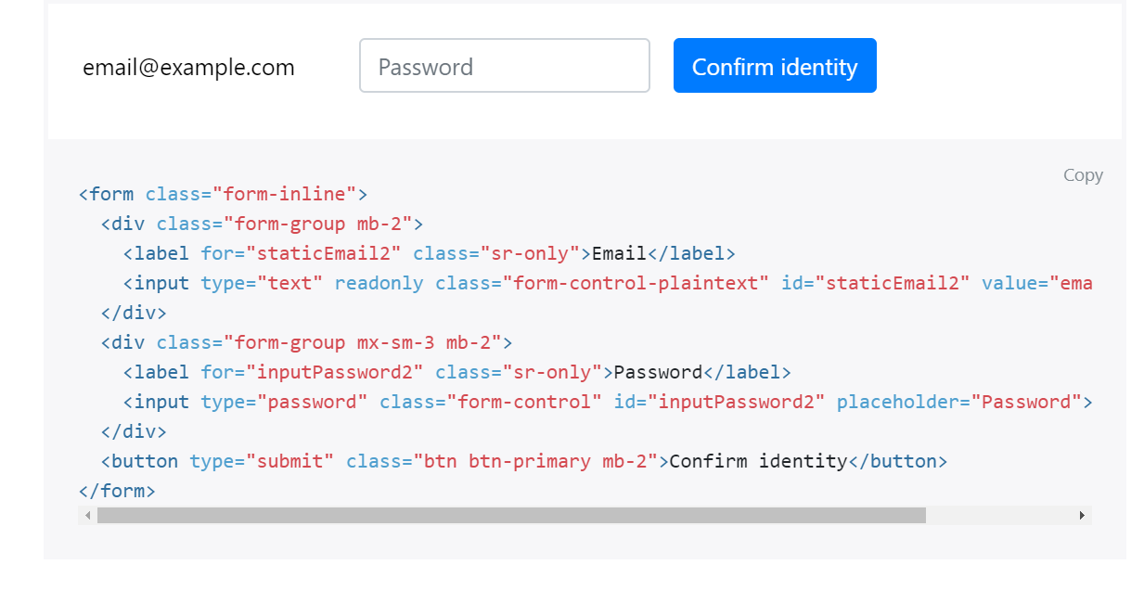
FORM-INLINE

Slide 57
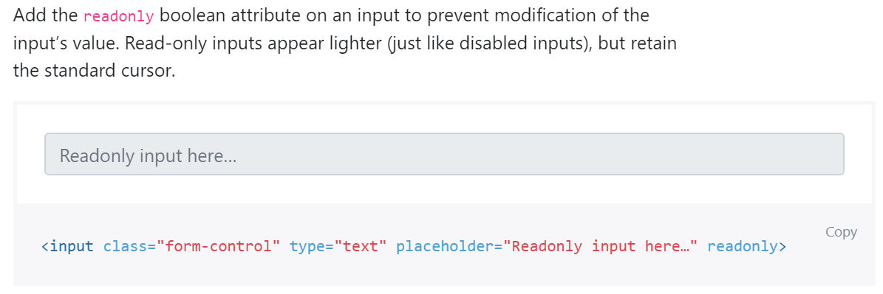
READONLY

Slide 58
DISABLED

Slide 59
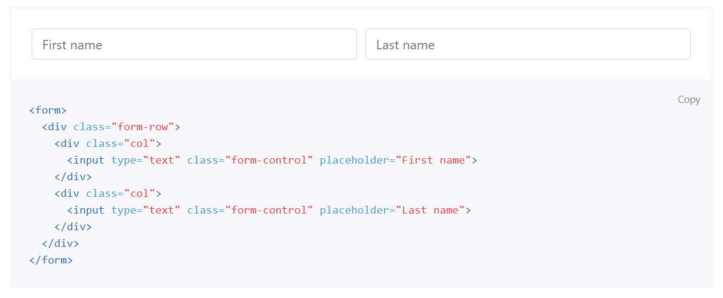
FROM GRID

Slide 60
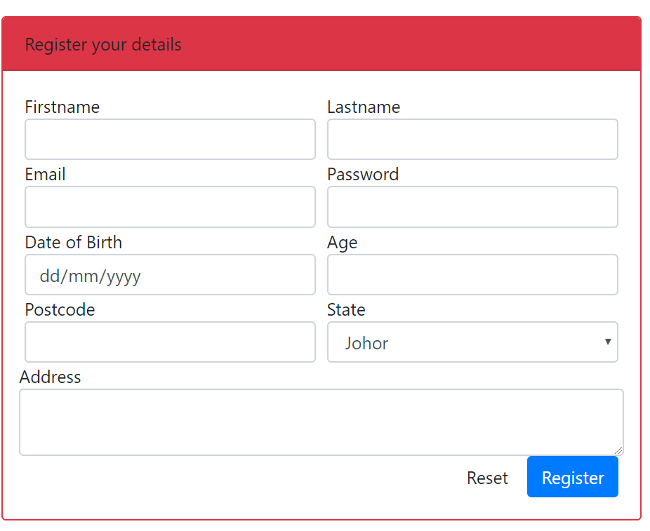
OUTPUT PREVIEW

Slide 61
T03: PHP syntax & echo T04: //comments T05: $variables & concat
w
bit.ly/fstmtube

Slide 62
Introduction
What is Web programming:
Combination of server-side and client-side to develop a dynamic website.
The application is deployed in the Web environment and can be access by multiple concurrent users.

Slide 63
Introduction to PHP
Server-side Scripting | Client-side scripting
The script embedded inside the HTML page, interpreted and executed inside the server (the web server) and the result/output of the execution is sent to the browser. The script interpreted and executed inside the server. E.g.: PHP, ASP, .NET, JSP | The script embedded inside the HTML page, downloaded with the HTML page and executed on the client (browser). E.g.: JavaScript.

Slide 64
Introduction to PHP
PHP= PHP: Hypertext Preprocessor:
Is a server-side scripting language.
PHP scripts are executed on the server, and the output from the process is inserted to the Web page as a part of the content before transmitted to the browser.
The script will not be sent to the browser which request the Web page, so the script is not visible to the users.

Slide 65
Introduction to PHP
Why PHP?
Runs on different platforms (Windows, Linux, Unix, etc.).
Is compatible with almost all servers used today (Apache, IIS, etc.).
Is free to download.
Is easier to learn and runs efficiently on the server side.

Slide 66
PHP Script Tag
A PHP scripting block always starts with <?php and ends with ?>
A PHP scripting block can be placed anywhere in the document.
On servers with shorthand support enabled ( enable in php.ini) may start a scripting block with <? and end with ?>

Slide 67
PHP Script Tag
A PHP file normally contains HTML tags, just like an HTML file, and some PHP scripting code.
Next, we have an example of a simple PHP script which sends the text “Assalamualaikum" to the browser:

Slide 68
PHP Script Tag
<html>
<head>
<title> Web Programming </title>
</head>
<body>
<?php
echo "Assalamualaikum";
?>
</body>
</html>

Slide 69
PHP Script TAG
Each code line in PHP must end with a semicolon ( ; ).
The semicolon is a separator and is used to distinguish one set of instructions from another.

Slide 70
PHP Script Tag
There are two basic statements to output text with PHP: echo and print.
In the example before, we have used the echo statement to output the text "Assalamualaikum".

Slide 71
PHP ECHO
<?php
$txt="Assalamualaikum!";
$x=23;
echo "Assalamualaikum!";
echo $x;
?>

Slide 72
T04 PHP SYNTAX //comment & $variable
FSTM KUIS

Slide 73
Comments in PHP
Comment is remark inside code that will not be compiled (ignored when the program is compiled).
It will not effect the code.
It is a good practice to write the comment.
Comment is useful the tell others what is the program is doing.
Helps programmer to memorize what is he doing.

Slide 74
Comments in PHP
In PHP, we use:
// to make a single-line comment or
/* … */ to make a large comment block.

Slide 75
Comments in PHP
<html>
<head>
<title> Web Programming </title>
</head>
<body>
<?php //This is a comment /* This is a comment block */ ?>
</body>
</html>

Slide 76
T05 SYNTAX PHP VARIABLES & CONCAT
w
FSTM KUIS

Slide 77
PHP Variables
Variables are used for storing values, like text strings, numbers or arrays.
When a variable is declared, it can be used over and over again in your script.
All variables in PHP start with a $ sign symbol.
The correct way of declaring a variable in PHP:
Eg: $var_name = "Kerul";

Slide 78
PHP Variables (cont)
New PHP programmers often forget the $
sign at the beginning of the variable.
In that case it will not work.
Let's try creating a variable, containing a string and a variable, containing a number:

Slide 79
PHP Variables (cont)
<?php
$txt="Assalamualaikum!";
$x=23;
echo $txt;
?>

Slide 80
EXAMPLE ON VARIABLE
Write the echo( )statement to display the following message:
Assalamualaikum!23

Slide 81
Naming Rules for Variables
A variable name must start with a $
A variable name can only contain alpha-numeric characters and underscores (a-z, A-Z, 0-9, and _ ).
A variable name should contain no space.
If a variable name is more than one word, it should be separated with an underscore ($my_string), or with capitalization ($myString).

Slide 82
EXAMPLE
Decide whether the following variables are valid or invalid. Give your reason.
$apa 11) $my_books
$123lekuk 12) $_myFamily
$what-is-the-number 13) $my address
$_uji1 14) $my2numbers
$my name
$For
IF
$float
$variable_to_hold_names_or_matrix_for_students
$hasil*nombor

Slide 83
Lateral Values
Lateral is the exact/actual value.
The value could be number (integer or real), character, string, or Boolean.

Slide 84
Lateral Values (cont)
Integer:
Integer is round number.
For example, 10 is an integer.
E.g.:
$num = 10;
$num = -10;
Use negative sign for negative numbers.

Slide 85
Lateral Values (cont)
Float:
E.g.:
$temp = 21.1225;
$product = 0.0;

Slide 86
Lateral Values (cont)
Characters:
To assign a character value into a char variable, the value must be put inside a open and close single or double quote.
E.g.:
$nama = 'Encik';
$name = "Kerul";

Slide 87
Lateral Values (cont)
Boolean:
There are only two values for Boolean variable: true and false.
E.g.:
$eatalready = true;
$isInteger = false;

Slide 88
Lateral Values (cont)
String:
A group of characters.
Marked with single or double quote.
E.g.:
$stmt = "How are you";

Slide 89
Concatenation Operator
There is only one string operator in PHP.
The concatenation operator ( . ) is used to put two string values together.
To concatenate two string variables together, use the concatenation operator:
String name;

Slide 90
Concatenation (cont)
<?php $txt1="Assalamualaikum!"; $txt2="Have a nice day!";
$name=“kerul”; echo $txt1 . " " . $txt2; ?>

Slide 91
Concatenation (cont)
The simpler way in doing concatenation:
<?php $txt1="Assalamualaikum!"; $txt2="Have a nice day!";
echo "$txt1 $txt2"; ?>

Slide 92
Concatenation (cont)
Or, if you want to print the output in a separate line:
<?php $txt1="Assalamualaikum!"; $txt2="Have a nice day!";
echo "$txt1 <br> $txt2"; ?>

Slide 93
Concatenation (cont)
Array:
<?php $num[0]=3;
echo "Number ".$num[0];
echo "Number $num[0] ";//not possible
?>

Slide 94
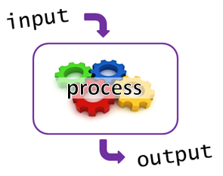
T05+1 Input Process Output
bit.ly/fstmtube

Slide 95
I-P-O
Input data
Process the data by converting into information
Output – convey the information as something meaningful

Slide 96
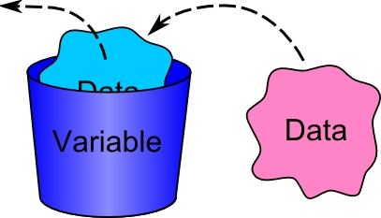
PHP Variables
Variables are used for storing values, like text strings, numbers or arrays.
All variables in PHP start with a $ sign symbol.
The correct way of declaring a variable in PHP:
Eg: $num1= 3; $num2=5;

Slide 97
Naming Rules for Variables
A variable name must start with a $
A variable name can only contain alpha-numeric characters and underscores (a-z, A-Z, 0-9, and _ ).
A variable name should contain no space.
If a variable name is more than one word, it should be separated with an underscore ($my_string), or with capitalization ($myString).

Slide 98
Arithmetic Operations
Operator | Operation | Example
 |  | Mathematical expression | PHP expression
+ | Addition | num1 + 3 | $total=$n1 + $n2;
- | Subtraction | pi - y | $q=$pi - $y;
* | Multiplication | width x height | $area=$width * $height;
/ | Division | a/b | $div=$a/$b;
% | Modulus | num modulo 2 | $even=$nom%3;

Slide 99
PROCESS: ADD 2 NUMBERS
Input process output
$num2 3
$num1 5
$total 8

Slide 100
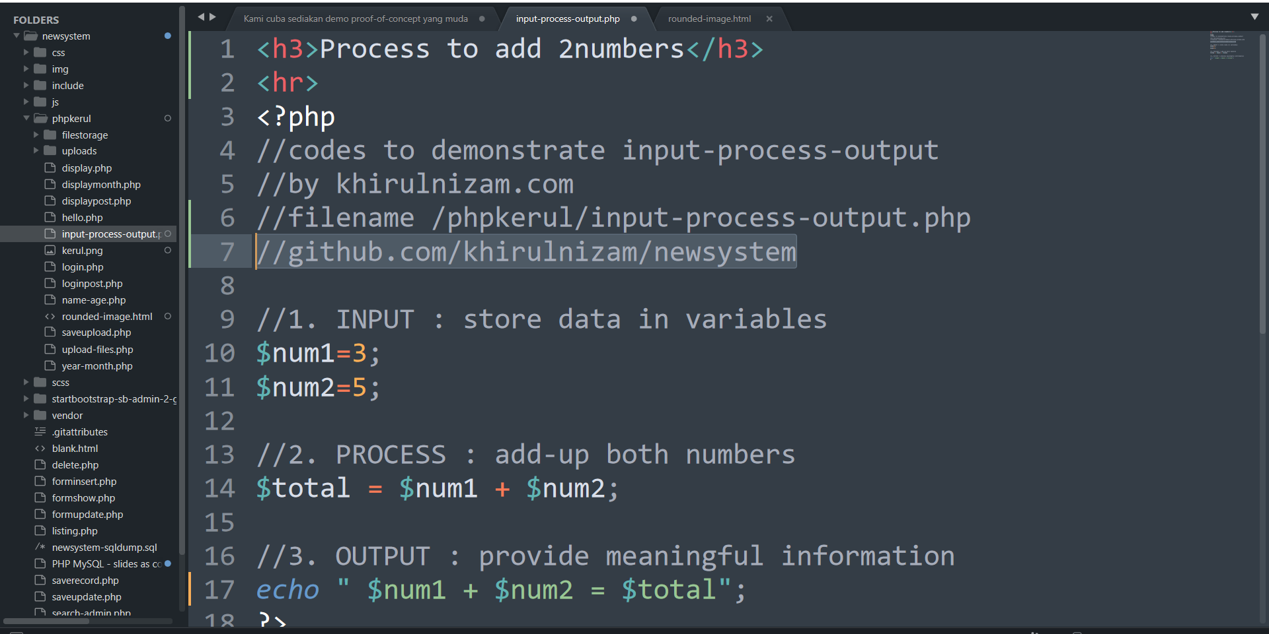
github.com/khirulnizam/newsystem

Slide 101





T06 INPUT FORM
FSTM KUIS

Slide 102
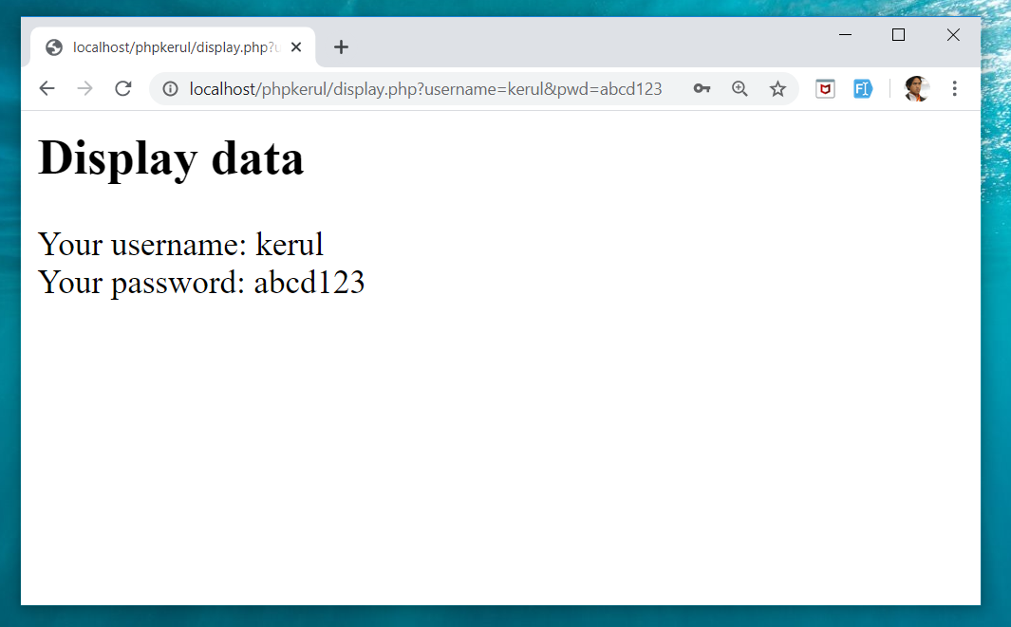
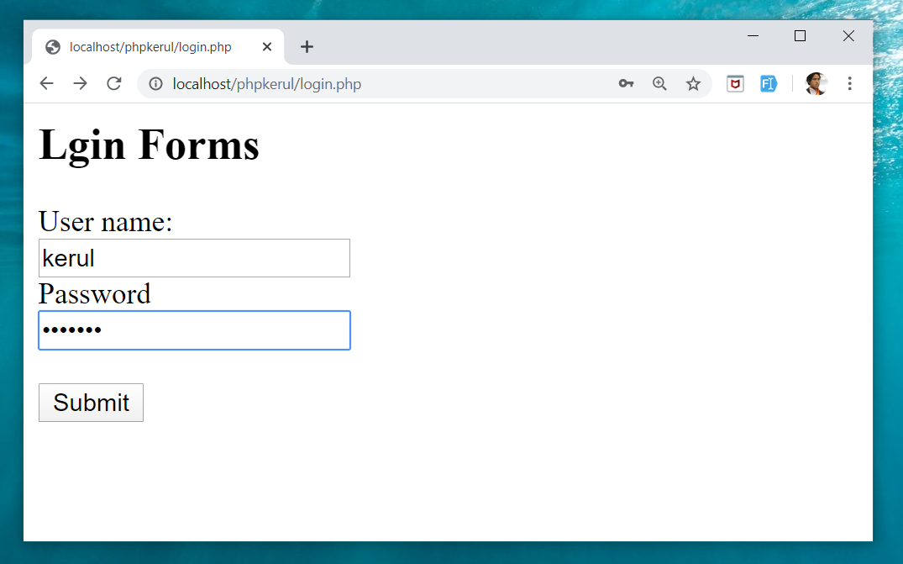
Example (cont)
display.php
login.php

Slide 103
Input Through HTML
<form name= "aform" method= "GET" action= "save.php" >
input…
</form>
This is the typical structure of form:
name: is the name of the form.
method: how the data is transferred (POST or GET).
action: is the target file resides in the Web server that receive the data from the form.
input: are the input elements (text field, checkbox, radio button, etc.).

Slide 104
GET vs. POST
GET | POST
Is basically for just getting (retrieving) data. The variable name and the value appear and visible in the URL. Form data is to be encoded (by a browser) into at the end of the URL of the target file. | Form data is embedded within a message body. POST may involve anything, like storing files to the server, updating data, ordering a product, or sending an e-mail. The variable name and the value do not appear in the URL.

Slide 105
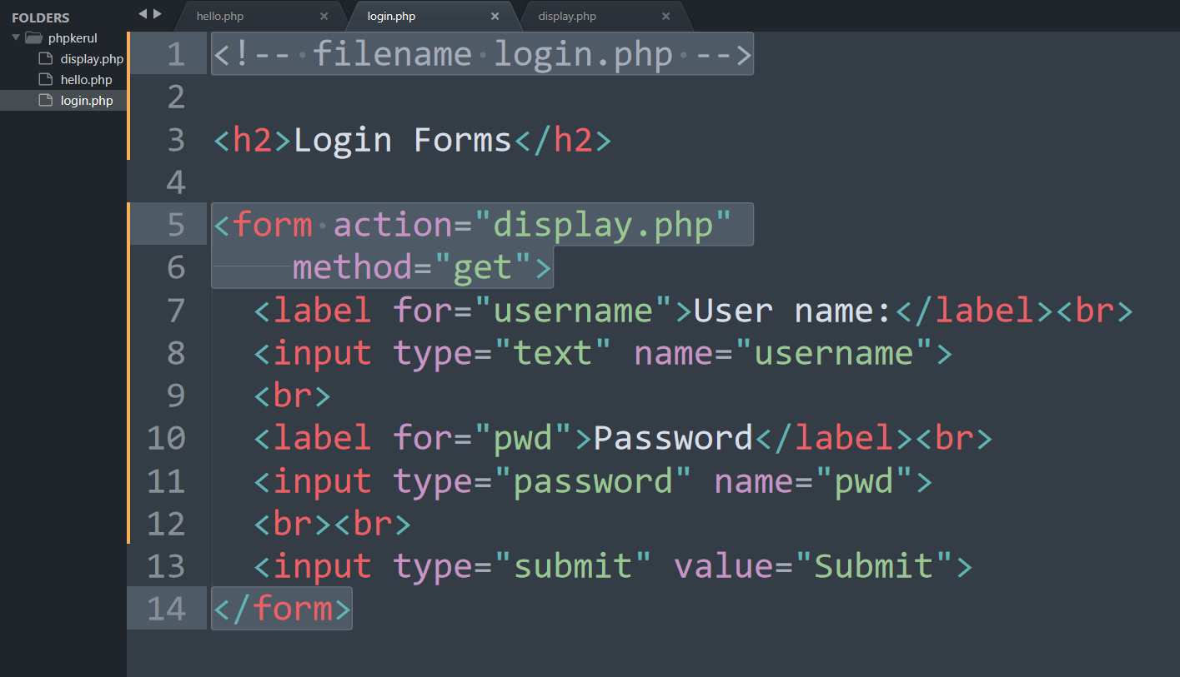
Example (Using GET Method)

Slide 106
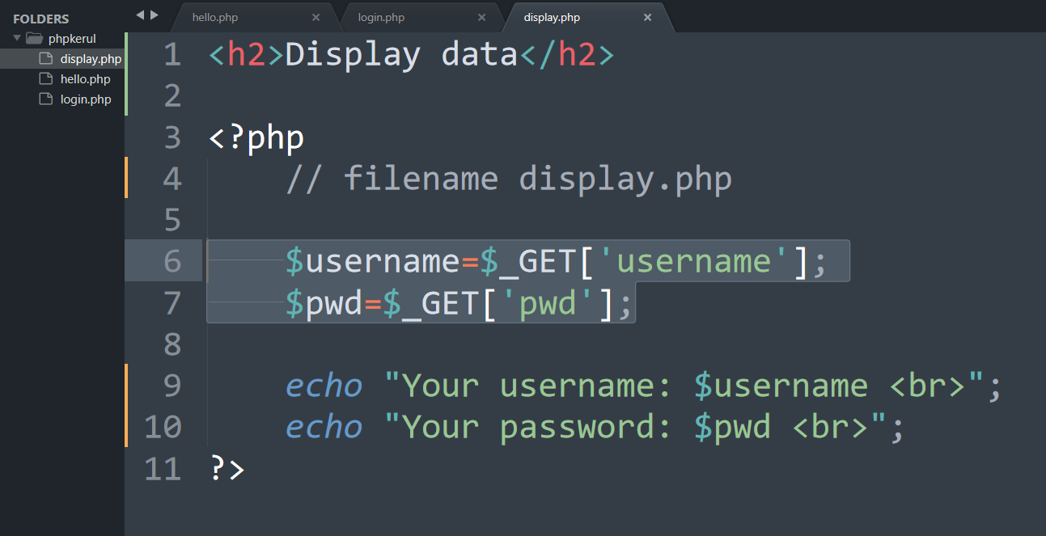
Display.php

Slide 107
Example (cont)

Slide 108
Example (Using POST Method)

Slide 109
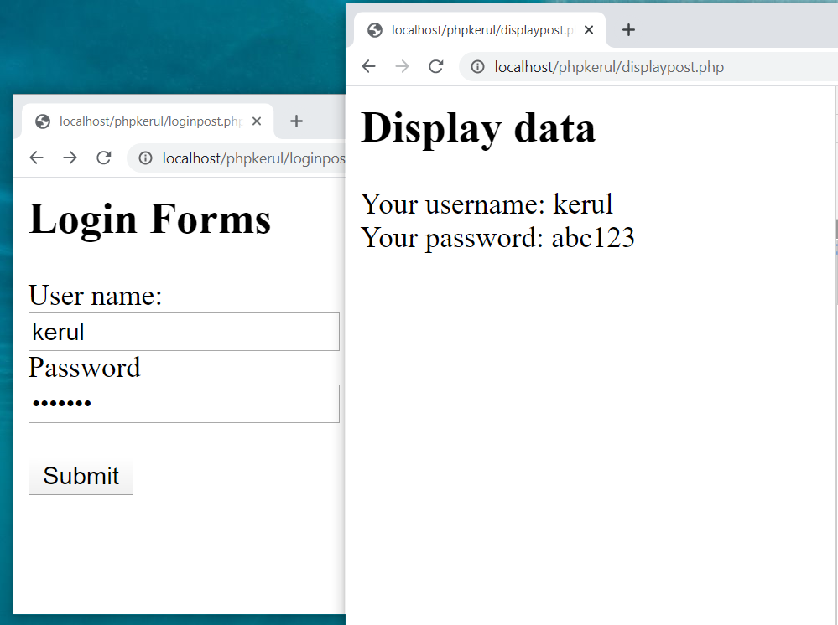

Slide 110
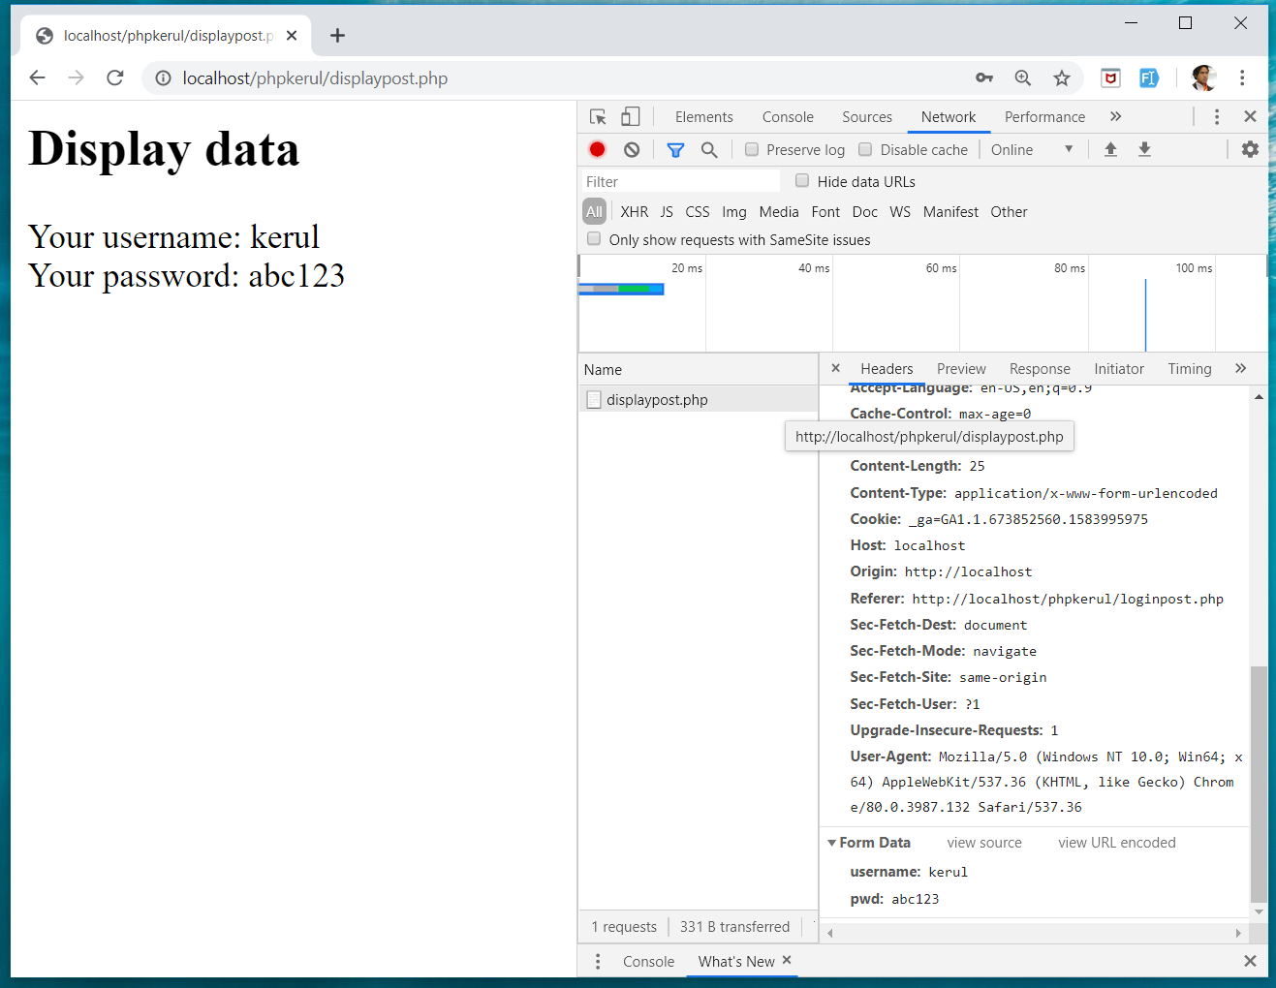
INSPECT TOOLS
F12

Slide 111
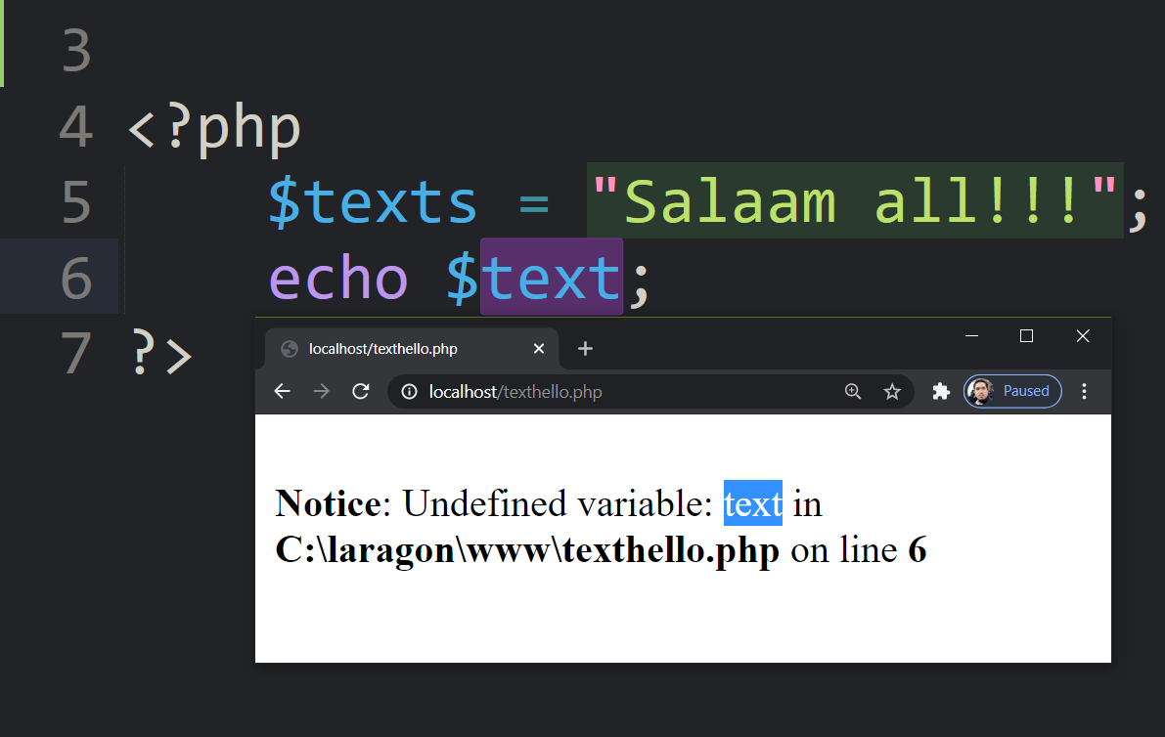
bit.ly/fstmkuis

Slide 112
if else SELECTION (Lecture Chapter06)
FSTM KUIS

Slide 113
Comparison Operators
Operator | Meaning | Example
== | Equal to | ($num == 100)
!= | Not equal to | ($letter != ‘Z’)
< | Less than | ($num1 < $num2)
> | Greater than | ($mark > 80)
<= | Less than or equal to | ($sum <= 10)
>= | Greater than or equal to | ($sum >= $input)

Slide 114
Selection in PHP
if is a PHP reserved words to perform selection:
Simple if: for one choice selection
if…else: for two choices selection

Slide 115
Simple if
E.g.:
if ($grade == 'A')
echo 'Excellent';
else if ($grade == 'F')
echo 'Try again’;
else

Slide 116
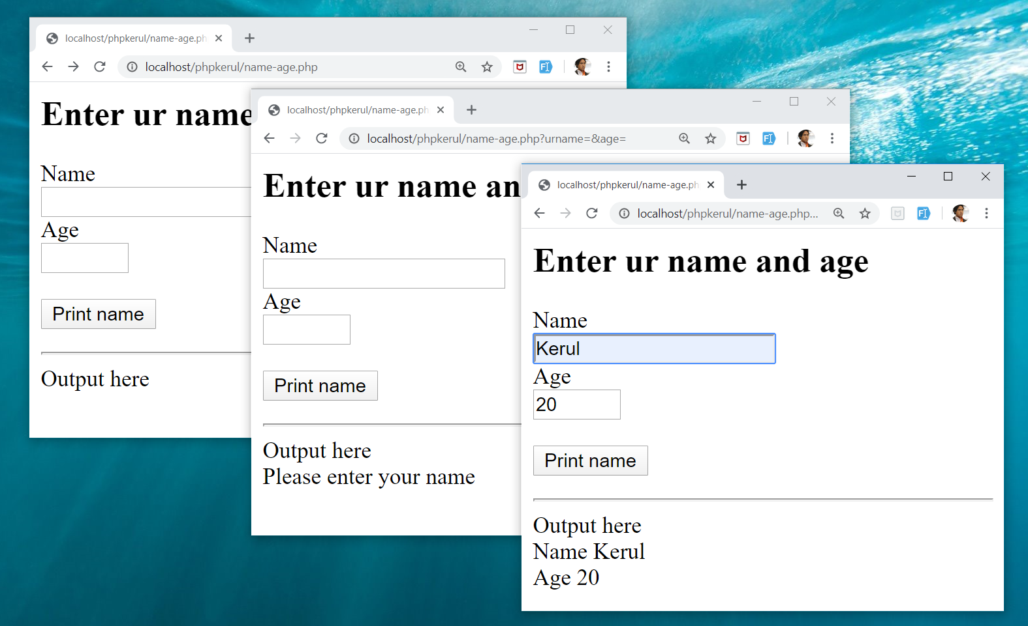
Example

Slide 117

FORM (name-age.php )

Slide 118

THE PHP IF…ELSE

Slide 119
ITERATION (LECTURE CHAPTER07)
FSTM KUIS

Slide 120
Repetition in PHP
There are many ways of doing repetition. Three of them:
for
while and do…while
foreach

Slide 121

for structure
E.g.:
<?php
for ($i=1;$i<=9;$i++){
echo "$i<br>";
}
?>

Slide 122

OUTPUT SAMPLE

Slide 123


DISPLAY YEARS in DROPDOWN

Slide 124

SELECT
OPTION

Slide 125
T09 ARRAY (Eng)
FSTM KUIS

Slide 126
Introduction of Array
A variable is a storage area holding a number or text. The problem is a variable hold only one value.
An array is a special variable, which can store multiple values in one single variable.

Slide 127
Introduction of Array (cont)
If you have a list of items (a list of student names, for e.g.), storing the student names in single variables could look like this:
$std1="Anas"; $std2="Hajar"; $std3="Shah";

Slide 128
Introduction of Array
In PHP, there are 3 kind of arrays:
Numeric array - An array with a numeric index.
Assign using AUTOMATIC method.
Assign using MANUAL method.
Associative array - An array where each ID key is associated with a value.
Multidimensional array - An array containing one or more arrays.

Slide 129
Numeric Array
Assign using AUTOMATIC method (change index starts at 1).
$month = array(1=>"Jan", "Feb", "March",
"April", "May", "June");
index | $month[1] | $month[2] | $month[3] | $month[4] | $month[5] | $month[6]
value | Jan | Feb | March | April | May | June

Slide 130
NUMERIC ARRAY
Assigning array with values using MANUAL method.
$month[1]="Jan"; $month[2]="Feb"; $month[3]="March"; $month[4]="April";

Slide 131
Example
<?php
$std[0]="Anas";
$std[1]="Hajar";
$std[2]="Shah";
$std[3]="Nurul";
echo $std[0] . " and " . $std[1] . " are students of FSTM.";
?>

Slide 132

Associative Array
$record['rollno']=5;
$record['name']="Kerul";
$record['phone’]=90346;

Slide 133
SELECT
OPTION

Slide 134

FOREACH

Slide 135
Pengulangan
for{i=1; i<=3000; i++}

Slide 136

for{i=1; i<=3000; i++}
khirulnizam.com

Slide 137
T10 FILE UPLOAD (MUAT-NAIK FAIL)
w
bit.ly/fstmtube

Slide 138
DISCLAIMER
Codes are for demo purposes. Example showed here are only to validate the proof of concepts. Security aspect the demonstrated examples are beyond the coverage of these tutorials. You are advised to explore / sought after advanced topics of PHP web programming as the issues are covered in the advanced level.

Slide 139
move_uploaded_file function
The move_uploaded_file() function moves an uploaded file to a new location.
This function returns TRUE on success, or FALSE on failure.
Syntax:
move_uploaded_file(file,newloc)
file: Specifies the file name.
newloc: Specifies the new location (destination) for the file.

Slide 140
PHP.ini
In php settings ( locate file php.ini from Laragon), turn-on the file upload
file_uploads = On

Slide 141
UPLOAD FORM (ONLY FOR IMAGE)
<!DOCTYPE html> <html> <body> <form action= "saveupload.php" method="post" enctype="multipart/form-data"> Select image to upload: <input type="file" name="fileToUpload" <input type="submit" value="Upload Image" name="submit"> </form> </body> </html>

Slide 142

enctype
enctype="multipart/form-data" - POST request with file-upload, have to encode the data that forms the body of the request.
<input name="fileToUpload" type="file" > - the form control to choose a file and upload to server.

Slide 143

OUTPUT

Slide 144

PHP to store image in server
Source: www.w3schools.com/php/php_file_upload.asp

Slide 145

PHP to store image in server
Source: www.w3schools.com/php/php_file_upload.asp

Slide 146

PHP to store image in server
Source: www.w3schools.com/php/php_file_upload.asp

Slide 147
OUTPUT

Slide 148

T11 php OOP (PENGATURCARAAN BERASASKAN OBJEK)
bit.ly/fstmtube

Slide 149





OOP
Object Oriented Programming - We can imagine our surroundings are full of objects cars, trees, houses, etc. Same way there is object oriented programming concepts which assume everything as an object and implement a software/system parts using different objects.
w3schools

Slide 150



FUNCTION IN PHP
A function is a block of statements that can be used repeatedly in a program.
Without arguments.
With arguments.

Slide 151
MODULAR PHP FUNCTION
Tokenization
Post Tagging
Vocab
Outside Vocab
Annotati
Output generation
Input file

Slide 152
Class
PHP OOP
Methods
Properties
Classes and objects are the two main aspects of object-oriented programming.
Class
Method/function
Object call
Constructor
Static method/property
Inheritance

Slide 153

PHP Class

Slide 154

CLASS Method

Slide 155


PHP Class with Constructor

Slide 156
PHP Object Call

Slide 157


STATIC METHOD/PROPERTIES
w3schools

Slide 158

INHERITANCE
Inheritance in OOP = When a class derives from another class.
The child class will inherit all the public and protected properties and methods from the parent class. In addition, it can have its own properties and methods.
An inherited class is defined by using the extends keyword.
Parent /
Superclass
Child/Subclass

Slide 159

EXAMPLE ON INHERITANCE

Slide 160

INHERITANCE: PHP FRAMEWORK
bit.ly/fstmtubelaravel

Slide 161

T12 PREPARING MYSQL DATABASE SERVER (PANGKALAN DATA)
bit.ly/fstmtubephpmysql

Slide 162

T12 PREPARING MYSQL DATABASE SERVER (PANGKALAN DATA)
bit.ly/fstmtubephpmysql

Slide 163
DISCLAIMER
Codes are for demo purposes. Example showed here are only to validate the proof of concepts. Security aspect the demonstrated examples are beyond the coverage of these tutorials. You are advised to explore / sought after advanced/security topics of PHP web programming as these tutorials only for beginner level.

Slide 164
CONNECT TO MYSQL DATABASE
mysqli/PDO
E-book PHP&Mysqli get it from
khirulnizam@gmail.com or
http://fb.com/khirulnizam or
Instagram @kerul_net
These vids tutorial will cover mysqli/PDO

Slide 165

CHANGE DBSERVER ROOT PASSWORD

Slide 166

ENTER PASSWORD

Slide 167


START ALL

Slide 168


CREATE NEW DB

Slide 169

HEIDI SQL (MYSQL CILENT)

Slide 170

CREATE NEW TABLE
Right-click on dbname

Slide 171

TABLE STRUCTURE : STUDENTS
Table name: students
set auto_increment for field id

Slide 172

POPULATE DUMMY DATA
Right-click to insert new row

Slide 173
T13 DBCONNECT PDO (PANGKALAN DATA PDO)
bit.ly/fstmtubephpmysql

Slide 174
T13 DBCONNECT PDO (PANGKALAN DATA PDO)
bit.ly/fstmtubephpmysql

Slide 175
DISCLAIMER
Codes are for demo purposes. Example showed here are only to validate the proof of concepts. Security aspect the demonstrated examples are beyond the coverage of these tutorials. You are advised to explore / sought after advanced/security topics of PHP web programming as these tutorials only for beginner level.

Slide 176
CONNECT TO MYSQL DATABASE
mysqli/PDO
E-book PHP&Mysqli get it from
khirulnizam@gmail.com or
http://fb.com/khirulnizam or
Instagram @kerul_net
These vids tutorial will cover mysqli/PDO

Slide 177

WHY PDO ?
PDO – PHP Data Object
Support different database
mysqli – only for MySQL
database connection
https://www.php.net/manual/en/book.pdo.php

Slide 178

TEST DBCONNECT TO DATABASE

Slide 179

HOW TO DISPLAY ALL RECORDS

Slide 180

EMBED SQL STATEMENT

Slide 181

SUBSCRIBE FSTM KUIS CHANNEL

Slide 182
T14 DBCONNECT using mysqli (Pangkalan Data mysqli)
bit.ly/fstmtubephpmysql

Slide 183
STAY HOME5, SAVE MALAYSIA! t14: mysqli
bit.ly/fstmphpmysqli

Slide 184
Database & RECORD LISTING (Eng Lecture Chapter 08-09)
FSTM KUIS

Slide 185
DISCLAIMER
Codes are for demo purposes. Example showed here are only to validate the proof of concepts. Security aspect the demonstrated examples are beyond the coverage of these tutorials. You are advised to explore / sought after advanced/security topics of PHP web programming as these tutorials only for beginner level.
Suitable to view in DESKTOP

Slide 186
CONNECT TO MYSQL DATABASE
mysqli
E-book PHP&Mysqli get it from
khirulnizam@gmail.com or
http://fb.com/khirulnizam or
Instagram @kerul_net
These vids tutorial will cover mysqli

Slide 187
3-tier – DATABASE CONNECTION
Tier3 : Database
Tier1 : Client/browser
Tier2 : Middleware (Webserver + PHP)

Slide 188
START ALL

Slide 189

CREATE NEW DB

Slide 190
CREATE NEW TABLE
Right-click on dbname

Slide 191
TABLE STRUCTURE : STUDENTS
Table name: students
set auto_increment for field id

Slide 192
POPULATE DUMMY DATA
Right-click to insert new row

Slide 193

PREPARE DATABASE NAME & TABLE

Slide 194
mysqli_connect ( )
<?php
$servername = "localhost";//server location / IP number
$username = "root";//db admin username
$password = "abcd1234";//password for db admin username
$dbname = "newsystem";//database name
// Create connection
$conn = mysqli_connect($servername, $username,
$password, $dbname);

Slide 195

mysqli_connect ( )

Slide 196

TEST SQL COMMANDS

Slide 197
MSQLI FUNCTIONS
$result = mysqli_query($conn, $sql)
PHP.net/mysqli_query : Performs an SQL query on the database
if (mysqli_num_rows($result) > 0)
PHP.net/mysqli_num_rows : Gets the number of rows in a result
while($row = mysqli_fetch_assoc($result)) {
PHP.net/mysqli_fetch_assoc : Fetch a result row as an associative array

Slide 198
Associative Array
$record['rollno']=4;
$record['name']="Jhon";
$record['phone']=456785;

Slide 199

EMBED SQL IN PHP

Slide 200

DISPLAY RESULT SET

Slide 201
SUBSCRIBE FSTM KUIS CHANNEL

Slide 202
T15 SEARCH IN DB (Carian dalam DB)
bit.ly/fstmtubephpmysql

Slide 203
SEARCH RECORD (Chapter 10 - English)
FSTM KUIS

Slide 204
DISCLAIMER
Codes are for demo purposes. Example showed here are only to validate the proof of concepts. Security aspect the demonstrated examples are beyond the coverage of these video tutorials. You are advised to explore / sought after advanced/security topics of PHP web programming as these tutorials only for beginner level.
Suitable to view in DESKTOP

Slide 205
CONNECT TO MYSQL DATABASE
mysqli
E-book PHP&Mysqli get it from
khirulnizam@gmail.com or
http://fb.com/khirulnizam or
Instagram @kerul_net
Video tutorial will cover mysqli

Slide 206
Code & Slides github.com/khirulnizam/ newsystem

Slide 207

CODE: search.php

Slide 208

POPULATE DATA INSIDE TABLE

Slide 209
Next

Slide 210

T16 BOOTSTRAP TEMPLATE
bit.ly/fstmtphpmysqli

Slide 211
T12 BOOTSTRAP INTERFACE
F FSTM KUIS

Slide 212
EXAMPLE OF IMPLEMENTATION

Slide 213
GITHUB
https://github.com/khirulnizam/newsystem

Slide 214
DISCLAIMER
Codes are for demo purposes. Example showed here are only to validate the proof of concepts. Security aspect the demonstrated examples are beyond the coverage of these video tutorials. You are advised to explore / sought after advanced/security topics of PHP web programming as these tutorials only for beginner level.
Suitable to view in DESKTOP

Slide 215
CONNECT TO MYSQL DATABASE
mysqli
E-book PHP&Mysqli get it from
khirulnizam@gmail.com or
http://fb.com/khirulnizam or
Instagram @kerul_net
Video tutorial will cover mysqli

Slide 216
Include php
include ("header.php");
<our content>
include ("footer.php");

Slide 217
startbootstrap.com/themes/sb-admin-2/

Slide 218
EXAMPLE OF IMPLEMENTATION

Slide 219

T17 INSERT RECORD (MASUKKAN REKOD BAHARU)
bit.ly/fstmtphpmysqli

Slide 220
INSERT RECORD (Chapter 11 English)
FSTM KUIS

Slide 221
EXAMPLE OF IMPLEMENTATION

Slide 222
GITHUB
https://github.com/khirulnizam/newsystem

Slide 223
DISCLAIMER
Codes are for demo purposes. Example showed here are only to validate the proof of concepts. Security aspect the demonstrated examples are beyond the coverage of these video tutorials. You are advised to explore / sought after advanced/security topics of PHP web programming as these tutorials only for beginner level.
Suitable to view in DESKTOP

Slide 224
CONNECT TO MYSQL DATABASE
mysqli
E-book PHP&Mysqli get it from
khirulnizam@gmail.com or
http://fb.com/khirulnizam or
Instagram @kerul_net
Video tutorial will cover mysqli

Slide 225
OVERVIEW

Slide 226

forminsert.php

Slide 227

forminsert.php

Slide 228

forminsert.php

Slide 229

INSERT INTO SQL GENERAL FORMAT

Slide 230

T18 SHOW DETAILS (Paparan semua data rekod)
bit.ly/fstmphpbootstrap

Slide 231

OVERVIEW

Slide 232
DISCLAIMER
Codes are for demo purposes. Example showed here are only to validate the proof of concepts. Security aspect the demonstrated examples are beyond the coverage of these video tutorials. You are advised to explore / sought after advanced/security topics of PHP web programming as these tutorials only for beginner level.
Suitable to view in DESKTOP

Slide 233
CONNECT TO MYSQL DATABASE
mysqli
E-book PHP&Mysqli get it from
khirulnizam@gmail.com or
http://fb.com/khirulnizam or
Instagram @kerul_net
Video tutorial will cover mysqli

Slide 234
Code & Slides github.com/khirulnizam/ newsystem

Slide 235
OVERVIEW

Slide 236
search-admin.php

Slide 237


Slide 238
formshow.php

Slide 239


Slide 240


Slide 241


Slide 242
Code & Slides github.com/khirulnizam/ newsystem

Slide 243

T19 UPDATE RECORD (Kemaskini data rekod)
bit.ly/fstmphpbootstrap

Slide 244

UPDATE RECORD PROCESS
search-admin.php
id
id

Slide 245
OVERVIEW
Cancel
Save Record

Slide 246
DISCLAIMER
Codes are for demo purposes. Example showed here are only to validate the proof of concepts. Security aspect the demonstrated examples are beyond the coverage of these video tutorials. You are advised to explore / sought after advanced/security topics of PHP web programming as these tutorials only for beginner level.
Suitable to view in DESKTOP

Slide 247
CONNECT TO MYSQL DATABASE
mysqli
E-book PHP&Mysqli get it from
khirulnizam@gmail.com or
http://fb.com/khirulnizam or
Instagram @kerul_net
Video tutorial will cover mysqli

Slide 248
Code & Slides github.com/khirulnizam/ newsystem

Slide 249

UPDATE COMMAND SQL

Slide 250

T20 DELETE RECORD (Padam rekod)
bit.ly/fstmphpbootstrap

Slide 251

UPDATE RECORD PROCESS
search-admin.php
id
confirmdelete( )
id

Slide 252
OVERVIEW
Save Record

Slide 253
DISCLAIMER
Codes are for demo purposes. Example showed here are only to validate the proof of concepts. Security aspect the demonstrated examples are beyond the coverage of these video tutorials. You are advised to explore / sought after advanced/security topics of PHP web programming as these tutorials only for beginner level.
Suitable to view in DESKTOP

Slide 254
CONNECT TO MYSQL DATABASE
mysqli
E-book PHP&Mysqli get it from
khirulnizam@gmail.com or
http://fb.com/khirulnizam or
Instagram @kerul_net
Video tutorial will cover mysqli

Slide 255
Code & Slides github.com/khirulnizam/ newsystem

Slide 256

UPDATE COMMAND SQL

Slide 257
T21 INNER JOIN (Gabungan dua jadual)

Slide 258


1-Many relationship

Slide 259
DISCLAIMER
Codes are for demo purposes. Example showed here are only to validate the proof of concepts. Security aspect the demonstrated examples are beyond the coverage of these video tutorials. You are advised to explore / sought after advanced/security topics of PHP web programming as these tutorials only for beginner level.
Suitable to view in DESKTOP

Slide 260
CONNECT TO MYSQL DATABASE
mysqli
E-book PHP&Mysqli get it from
khirulnizam@gmail.com or
http://fb.com/khirulnizam or
Instagram @kerul_net
Video tutorial will cover mysqli

Slide 261
Code & Slides github.com/khirulnizam/ newsystem

Slide 262

DISPLAY OPTIONS FROM TABLE TO DROP-DOWN

Slide 263

OUTPUT

Slide 264
T22 INNER JOIN DISPLAY (Papar gabungan dua jadual)

Slide 266
1-Many relationship

Slide 267
DISCLAIMER
Codes are for demo purposes. Example showed here are only to validate the proof of concepts. Security aspect the demonstrated examples are beyond the coverage of these video tutorials. You are advised to explore / sought after advanced/security topics of PHP web programming as these tutorials only for beginner level.
Suitable to view in DESKTOP

Slide 268
CONNECT TO MYSQL DATABASE
mysqli
E-book PHP&Mysqli get it from
khirulnizam@gmail.com or
http://fb.com/khirulnizam or
Instagram @kerul_net
Video tutorial will cover mysqli

Slide 269
1-Many relationship

Slide 270

SQL: INNER JOIN

Slide 271

OUTPUT

Slide 272


MOBIRISE
Mobirise – a free web design studio that support HTML5 & Bootstrap’s famous ‘block’ design.

Slide 273

MOBIRISE
Done with the talking, lets walk the talk… ;)

Slide 274

Select theme

Slide 275

Start here

Slide 276

Select block

Slide 277


Slide 279

MOBIRES- CHANGING IMAGE

Slide 280

MOBIRES- TEXT EDITING

Slide 281


Slide 282


Slide 283

Thank you very much
Newton keep asking, Why apple FALL from tree?
Everybody asks silly questions before becoming a star…

